Slide 1

LaBoard’s Bowling Alley Simulation
By: Keaton LaBorde
Course: Data Modeling CSCI B450
Date: 12/10/2024

Slide 2
Introduction
Simulation models the operations of a bowling alley on Hilton Head Island!
Goal is to model the financials of the bowling alley including these key elements:
- Customer Flow
- Lane Utilization
- Revenue Generation
- Employee Labor Costs
- Seasonal Variations
- Maintenance Times

Slide 3
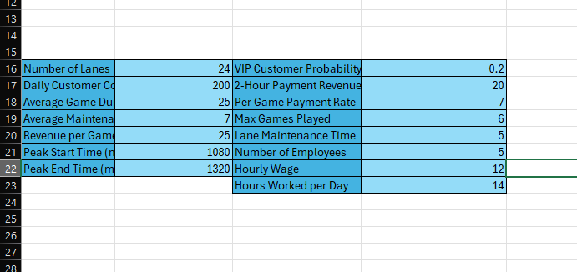
Model Description
More realistic M/M/c
M: Interarrival times follow Poisson distribution, M: Service times are exponentially distributed. C: Number of servers or lanes. Multi server queue with up to Number of Lanes. When a lane is occupied, the customer waits in a queue until a lane is available.
Key variables include:
Lane Count: Number of available lanes
Customer Count: Average number of customers per day
Game Duration & Maintenance: Time spent on each game and maintenance time after each game
Revenue Variables: Games, Food, and Beverage's sales
Employee Parameters: Number of employees, hourly wage, working hours
Fixed Peak Season: June through August and December, demand prices increase
Payment Options: Fixed 2-hour payment vs. per game

Slide 4
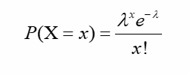
Assumptions
FCFS Queue Discipline
Exponential Distribution for service times
Poisson Arrival Process
Employees work 14 hours without breaks

Slide 5
Simulation Process
Problem: Identified key business variables such as customer flow and lane maintenance
Writing the code: Used VBA for flexible simulation and inputs can be altered dynamically
Customer Flow Simulation: Random number generator used for customer arrivals, adjusted for peak seasons
Lane Management: Simulated lane availability, considering both maintenance and customer wait time
Revenue and Cost Calculations: Tracked Revenue from games and food, and employee labor costs
Reporting: Calculated daily net profit and accumulated totals for yearly revenue and costs

Slide 6
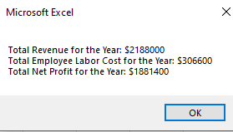
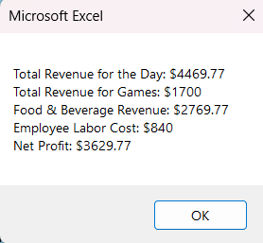
Results and Visualisation

Slide 7
Seasonal Impact on Revenue
Peak Season from June to August and December which increased Revenue 200%
More customers arrive and the average revenue per game increases

Slide 8
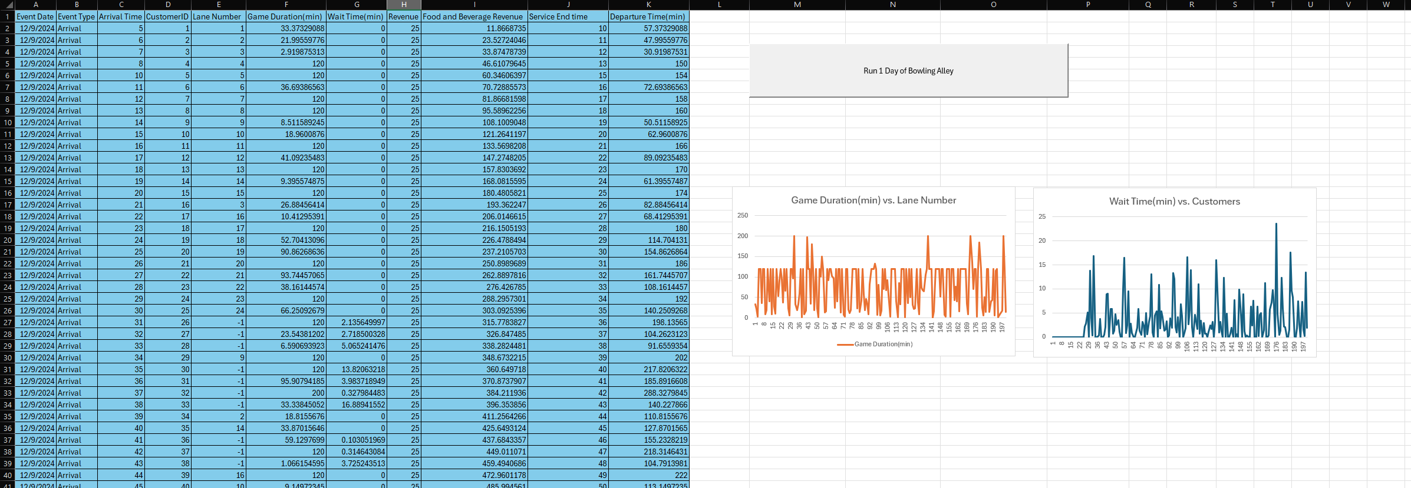
Breakdown of Revenue
Revenue can be affecting by time of day and season
Revenue Sources:
Game Revenue: Direct revenue from games played or 2-hours
Food & Beverage Revenue $10 per customer

Slide 9
Challenges Encountered
Lane Management: Properly simulating lane availability while considering maintenance and customer wait times
Dynamic Revenue: Variability in revenue based on customer choices and peak season adjustments
Peak Season Simulation: Adjusting the model to account for customer demand and price increases during peak times

Slide 10
Conclusion
Simulation mostly models the operations of a bowling alley on Hilton Head Island
Potential Areas for improvement:
Adjust dynamic pricing based on customer demand and employee availability
Create employee schedules
Could be down times where no lanes are running

Slide 11

Thank you
Questions?

